Slide 1
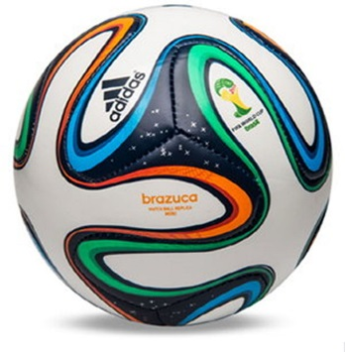
Joint Masjid Soccer Tournament Rules
9 vs. 9 Soccer Tournament Basic Laws and Regulations

Slide 2
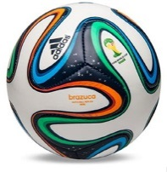
General rules
The “Group or Team Entry Form” and/or the “Single Player Entry Form” is turned to committee by Coach or Assistant coach for each team prior to the first game.
Roster modifications may be made up until the end of the first day of the tournament with permission from the tournament committee.
Player ID’s are required if other captain request before the game. The tournament will use the honor system to speed up check in. But
For youth & Sisters Smaller fields (~half the size of regulation fields or smaller depending on division) will be created for the 7 vs. 7 format. However, full size regulation goals will be used, so goalies are required.

Slide 3
General Rules
Tie breakers are Head to Head and based on goal differential in the pool stage.
Teams will receive 6 point for a win and 3 point for a tie, 1 point for shutouts and 1 point for each goal scored: Maximum of 10 points for winning a game.
Example:
Team A wins over Team B = 3 - 0 = Team A with 10 pts.
Team A = 6 pts. for the win + 1 pt. for the shut out + 3 pts. for 3 goals
There is no protesting of games “Period” once games are over.
Medals will be awarded to the championship winners and the runner ups.
Penalty Kicks from the mark will decide tiebreakers - committee oversight

Slide 4
Team Rules
Please arrive at least 15 minutes prior to your scheduled game.
Players can play in the age older divisions but cannot play in the younger divisions. Example: U14 can play with over 30 year old Pool, but 30 year old can’t play with U14 Pool.
A limited number of underage players can play in the older divisions. The committee will decide on a case by case situation.
Up to 2 younger players can join the above 30 teams.
Younger players age 12 and under will need tournament chairman/committee and parental approval to play in the divisions above U14. This is not recommended, but it is a committee decision based on size and skill of player.
Shin guards are required for all players.
Black shorts and soccer cleats, turf cleats or running shoes with good traction are recommended for your safety.
Keepers must wear a different color jersey than that worn by the field players.

Slide 5
Referee rules
Referees will follow the FIFA Laws of the game and USSF Guide to Referees. When not possible, “common sense” is the best law.
Teams must have a minimum of 5 players prior to the start of a game or risk forfeiting.
Prior to the game, referee must check to ensure players have shin guards.
A minimum of two referees per game is anticipated. We will try our best to have two Assistant referees for touchline and one Center experienced referee to run the diagonal system of play.
Offside FIFA Law 11 will be enforced to the best of the Referee’s ability or
not used depending on committee and referee crew.
6. The home team will kickoff and visitors will defend at the start of the game. The teams will switch sides at the start of the second half and the visitors will kickoff. This is to speed up the pool play. The Championship games will be conducted with the toss of a coin.

Slide 6
Referee rules
The Championship game will have an experienced 3 person referee crew.
Duration of the match will be 40 - 50 minutes (20 - 25 minute half) in the pool play based on the number of teams entering the tournament.
Halftime break is 5 to 10 min depending on the schedule and time.
Championship games will be 50 - 70 minutes (25 - 35 min half) at maximum
Free substitutions are allowed once the referee is notified and waives player on and off the field.
Substitution are allowed at anytime the ball is stopped during the 8 restarts in soccer or injury.
Keepers should have different jersey than field players.

Slide 7
Organizer Rules
Rules that are not posted on the website, will be up to the tournament organizers to decide on during the tournament. It is also up to the discretion of the committee to change and/or modify rules if necessary.
A minimum of four T-shirt colors will be used to assure teams in the pool can be differentiated on the fields.
Pennies (provided by the Tournament) may be used if two teams have the same T-shirt color.
Three to four team pools will be created to play within competitive level and age divisions.
Depending on the number of teams and players in a given division, the tournament chairman and committee may modify format from 7 vs. 7 but unlikely.
Depending on the number of teams and players, the tournament chairman and committee will determine the pools and groups.
The groups and pools will be balanced based on age and competitive levels and the committee will do its best to set a fair standard at all times for the tournament.

Slide 8
Frequently Asked Questions (FAQ)
Are sisters required to wear Hijab?
Sisters games will be played at a different time than the Brothers games. If sisters do not normally wear hijab, they are welcome to still participate without hijab. For sisters that do wear hijab, it is recommended for them to wear hijab because it is an outdoor public venue.
No shorts please, sweats or yoga type with long shirts over body

